Slide 1
Modelling of nonlinear light up-conversion from intense femtosecond laser pulses
DESY Summer Student Programme 2023
Project Presentation
Group: CFEL-ATTO
Supervisor: Josina Hahne
David Amorim (University of Glasgow)

Slide 2
Overview
13.06.2023

Slide 3
Motivation
13.06.2023

Slide 4
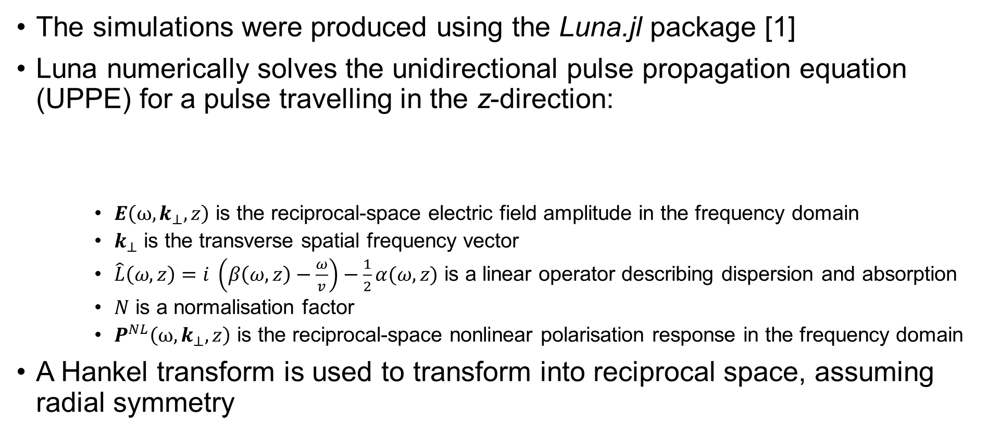
Background
The simulations were produced using the Luna.jl package [1]
Luna numerically solves the unidirectional pulse propagation equation (UPPE) for a pulse travelling in the z-direction:
$E\left(ω, k_{⊥},z\right)$ is the reciprocal-space electric field amplitude in the frequency domain
$k_{⊥}$ is the transverse spatial frequency vector
$\hat{L}\left(ω,z\right)=i \left(β\left(ω, z\right)−\frac{ω}{v}\right)−\frac{1}{2}α(ω,z)$ is a linear operator describing dispersion and absorption
$N$ is a normalisation factor
$P^{NL}\left(ω, k_{⊥},z\right)$ is the reciprocal-space nonlinear polarisation response in the frequency domain
A Hankel transform is used to transform into reciprocal space, assuming radial symmetry
13.06.2023
$$\frac{∂}{∂z}E\left(ω, k_{⊥},z\right)=\hat{L}\left(ω,z\right)E\left(ω, k_{⊥},z\right)+\frac{i ω}{N}P^{NL}\left(ω, k_{⊥},z\right)$$
(1)

Slide 5
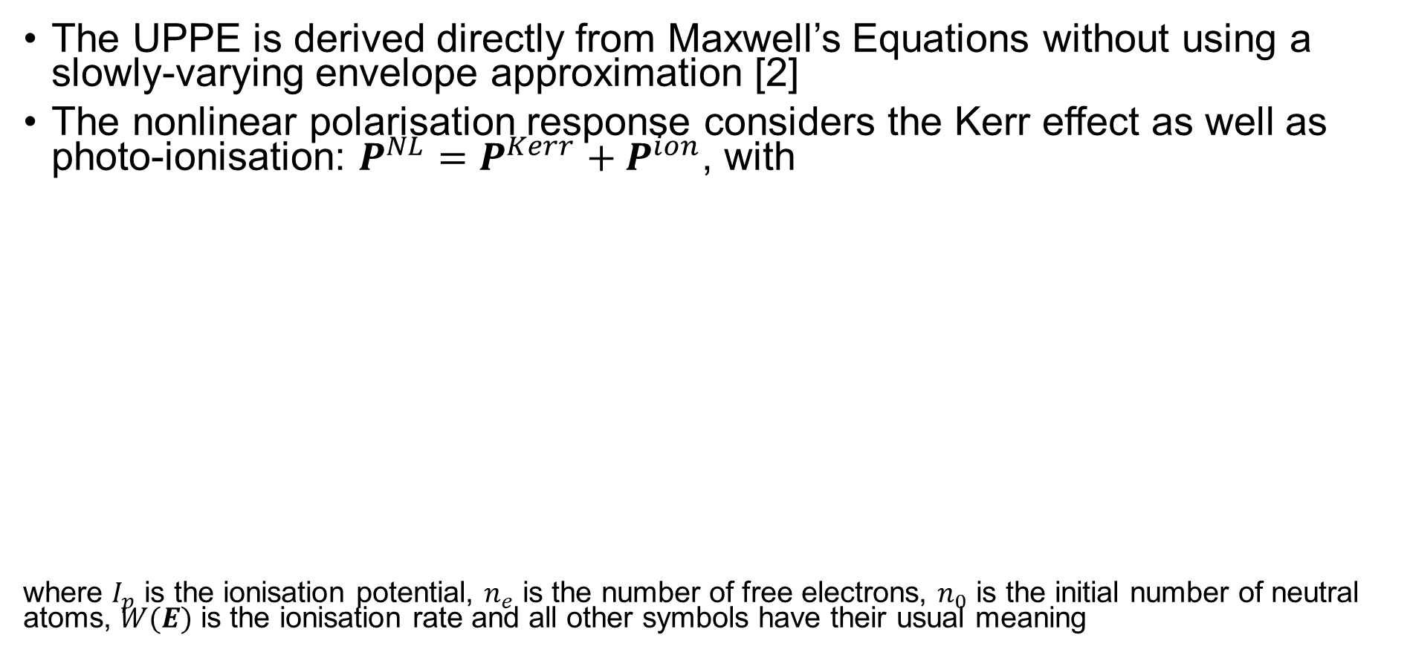
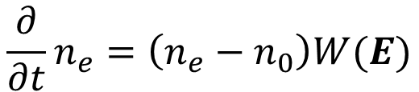
Background
The UPPE is derived directly from Maxwell’s Equations without using a slowly-varying envelope approximation [2]
The nonlinear polarisation response considers the Kerr effect as well as photo-ionisation: $P^{NL}=P^{Kerr}+P^{ion}$, with
where $I_{p}$ is the ionisation potential, $n_{e}$ is the number of free electrons, $n_{0}$ is the initial number of neutral atoms, $W(E)$ is the ionisation rate and all other symbols have their usual meaning
$$P^{Kerr}\left(t, r_{⊥},z\right)=χ^{\left(3\right)}{\left[E(t, r_{⊥},z)\right]}^{3}$$
(2)
$${\frac{∂}{∂t} P}^{ion}\left(t, r_{⊥}, z\right)=\frac{I_{p}}{E(t, r_{⊥},z)}\frac{∂n_{e}}{∂t}+\frac{e^{2}}{m_{e}^{2}}\int_{−∞ }^{t}{n_{e}\left(t^{′}\right)E(t^{′}, r_{⊥},z)dt′}$$
(3)
$$\frac{∂}{∂t}n_{e}=\left(n_{e}−n_{0}\right)W(E)$$
(4)

Slide 6
Simulation Output

Slide 7
References
[1] Luna
[2] Deriving UPPE from Maxwell’s Equations

